Slide 1
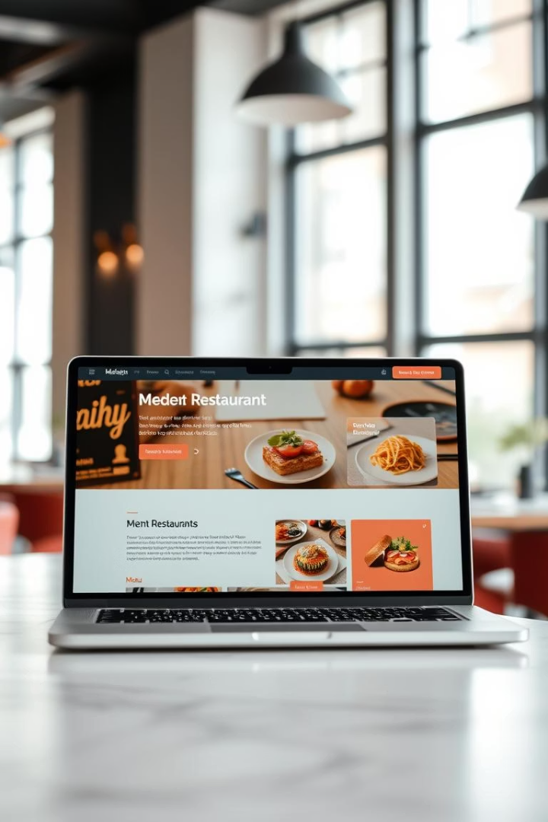
Restaurant Website Built with Laravel
This project involved creating a dynamic and user-friendly restaurant website using PHP Laravel, Composer, and MySQL. The site facilitates restaurant owners in managing menus and orders efficiently while providing an inviting experience for customers.
The target audience includes restaurant owners looking for streamlined online presence and tech enthusiasts interested in modern web development tools. Leveraging PHP and Laravel allowed us to create a scalable and maintainable platform.

Slide 2

Technology Stack: Laravel Framework
Laravel
Composer
Why Laravel?
A PHP framework renowned for its elegant syntax and MVC architecture, enabling clean and organized code development.
A dependency manager for PHP that simplifies the process of managing external libraries and packages.
Chosen for its strong security features, ease of use, and active community support, making it ideal for rapid web application development.

Slide 3
Database Design: MySQL
Database Overview
Relationships & Integrity
MySQL serves as the relational database management system, organizing crucial restaurant data effectively and reliably.
One-to-many: Categories to Menu Items
Many-to-many: Users with Orders
Enforced data normalization to reduce redundancy and maintain consistency
The schema includes tables for menu items, categories, users, and orders, ensuring structured storage of information.

Slide 4
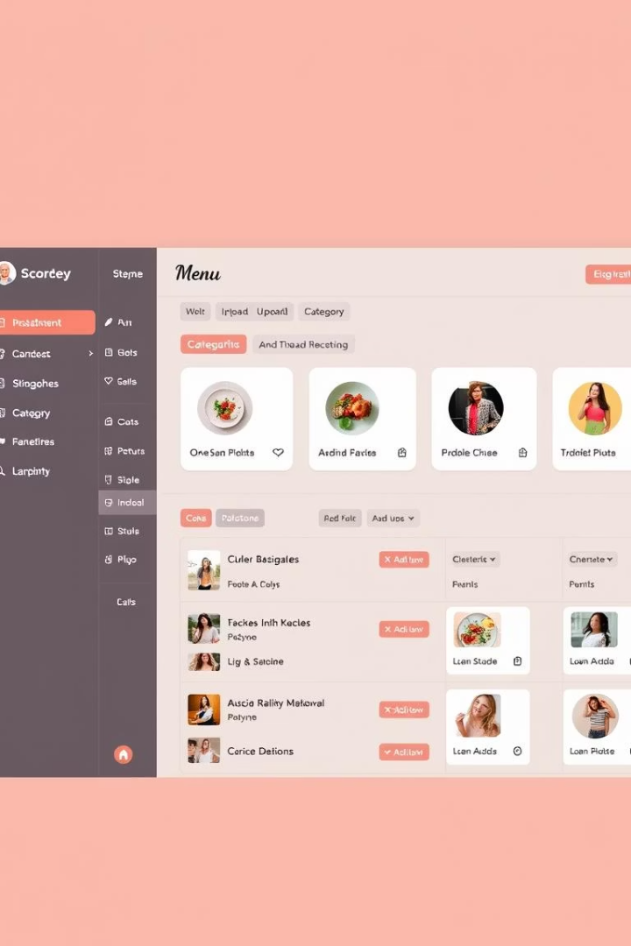
Key Features: Menu Management
Dynamic Menus
Admin Control
Menus update in real-time, pulling data dynamically from the database to reflect current offerings.
A comprehensive panel allows easy addition, editing, and deletion of menu items, streamlining restaurant updates.
Category & Search
Users can filter by categories or search keywords, enhancing usability and navigation across menu items.

Slide 5
Key Features: Order Management
Ordering System
User Security
Order Tracking & Payments
Customers can place orders online with a smooth shopping cart interface, making ordering convenient and fast.
Robust authentication protects user accounts, ensuring safe order placement and management.
Users receive live order status updates and can securely pay using integrated gateways like Stripe and PayPal.

Slide 6
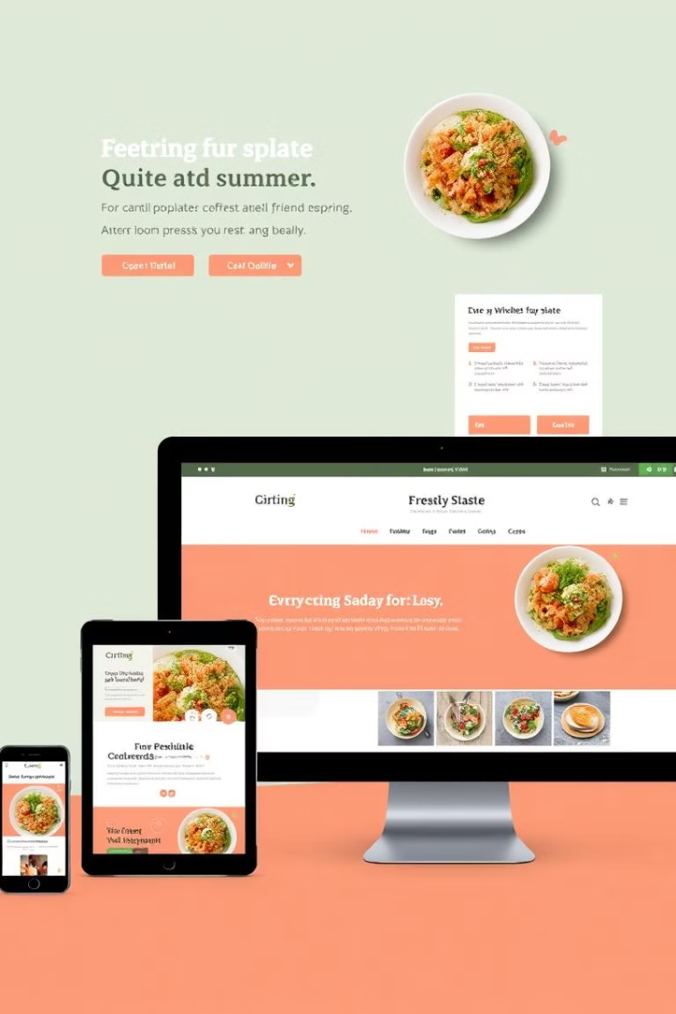



User Interface (UI) and Experience (UX)
Responsive Design
Intuitive Navigation
Visual Appeal
High-quality images and consistent branding create a welcoming and professional environment.
Optimized for viewing across desktops, tablets, and smartphones, ensuring consistent accessibility.
Easy-to-use menus and search improve user journey and satisfaction.

Slide 7
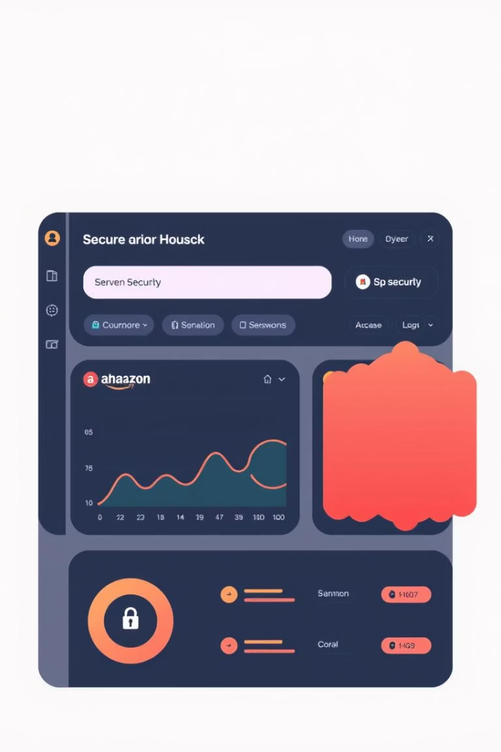
Security Considerations
Vulnerability Protection
Authentication & Passwords
Implemented safeguards against XSS, SQL injection, and other common attacks to protect data integrity.
Secure user authentication protocols and encrypted password storage ensure user privacy.
Validation & Audits
Rigorous input validation coupled with regular security audits keeps the platform secure and reliable.

Slide 8
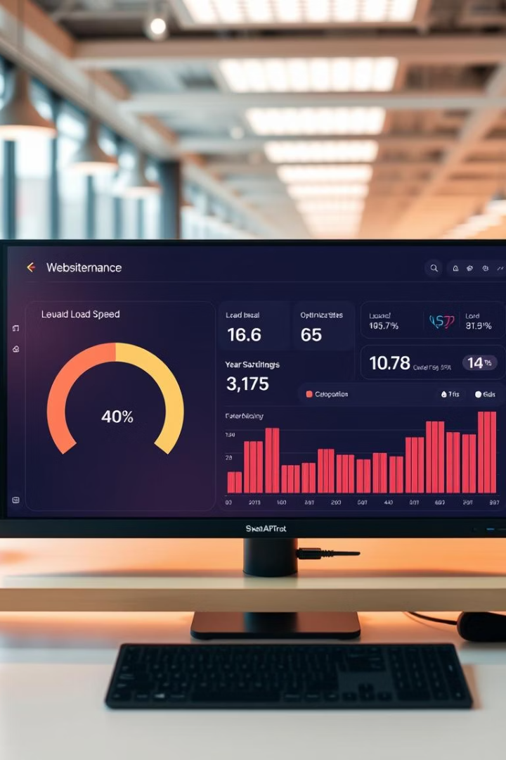
Performance Optimization
Caching Strategies
Implemented caching to minimize database queries and accelerate page loading times.
Image Optimization
Compressed and resized images ensure faster loading without sacrificing quality.
Code & CDN Use
Code minification and Content Delivery Networks speed up content delivery across global users.

Slide 9




Future Enhancements
Reservation System
1
Allow users to book tables online, increasing convenience and optimizing seating.
Customer Reviews
2
Implement a feedback system featuring ratings and reviews to boost customer engagement.
Social Media Integration
3
Connect the website with social platforms to enhance marketing and community building.
Payment Expansion
4
Add more payment options to cater to diverse customer preferences and improve conversion.

Slide 10

Conclusion and Q&A
Project Summary
Call to Action
The website successfully integrates Laravel, Composer, and MySQL to provide a robust restaurant management platform.
Explore the website to experience the features and functionality firsthand.
Discussion
We welcome your questions and insights to further refine and enhance the project.

